Slide 1


Enhancing Decision-Making with AI Analyst Personas
Organizations often struggle to incorporate diverse perspectives in decision-making. Our solution creates structured AI analyst personas using IBM watsonx.ai. These personas ensure a comprehensive, unbiased approach to research and decision-making.
by Sec Tester

Slide 2
The Problem: Bias in Decision-Making
Lack of Diverse Perspectives
Emergence of Biases
Organizations overlook critical viewpoints. This is especially true in data governance and policy formulation.
Without structured personas, biases can emerge. This leads to ineffective decisions.
Structured personas are essential for balanced, effective decision-making.

Slide 3




Our Solution: AI-Driven Analyst Personas
Stakeholder Representation
Dynamic Refinement
Represents industry experts, government officials, and academic researchers.
Generates, refines, and updates personas based on human feedback.
Unbiased Approach
Ensures a comprehensive and unbiased approach to research.

Slide 4

Target Users: Who Benefits?
Enterprises
Implementing AI governance frameworks.
Research Teams
In academia and industry settings.
Policymakers
And regulatory bodies.
Data Analysts
And business strategists.

Slide 5
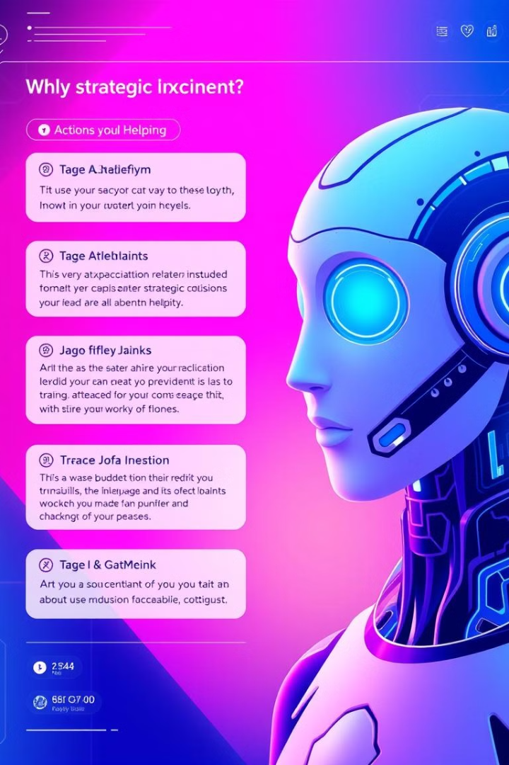




How It Works: User Interaction
Input Topic
User inputs a research topic and feedback.
Generate Personas
AI generates analyst personas.
Refine Personas
Users provide feedback to refine personas.
AI Advisors
Personas advise on research and policy.

Slide 6




Key Technologies: IBM watsonx.ai
Graph-Based Execution
1
Efficiently processes persona generation.
User Feedback
2
Iteratively refines personas.
Structured Persona Generation
3
Dynamically constructs analyst personas.
Natural Language Processing
4
Analyzes research topics and feedback.

Slide 7


GitHub Repository: Proof of Concept
Jupyter Notebook
Integration
Implementation of AI persona generation.
Integrates IBM watsonx.ai's ChatWatsonx model.
Execution Workflow
Incorporates LangGraph for iterative refinement.

Slide 8

Conclusion: Enhance AI Decision-Making
Our project ensures diverse, well-structured perspectives. By leveraging IBM watsonx.ai, we enhance AI's capability. Our solution is unique and scalable across industries.

